Slide 1
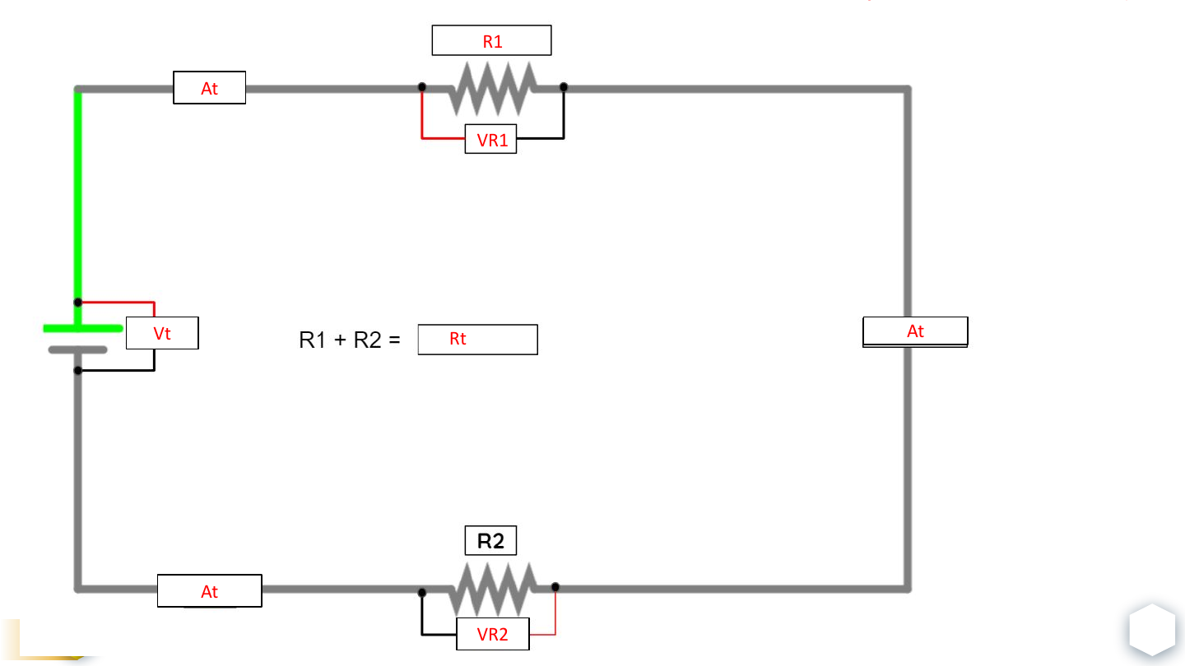
AUTOMOTIVE ELECTRICAL
Ohm's Law
Voltage, current, resistance, and power - organized for calculation, measurement, and diagnosis.
STUDENT VERSION
V = I x R | P = V x I
OHM'S LAW
01
Notes:
[Sources]
- User-provided source: EL - 05.1 Ohm's Law (Student Version).pdf
[/Sources]

Slide 2
CORE RELATIONSHIP
One small circuit connects all four quantities
1 V
1 ohm
1 A
1 W
across
produces
and
V = I x R
P = V x I
Voltage drives current through resistance.
Voltage and current determine power.
CORE RELATIONSHIP
02
Notes:
[Sources]
- User-provided source: EL - 05.1 Ohm's Law (Student Version).pdf
[/Sources]

Slide 3
LEARNING OUTCOMES
By the end, you should be able to...
01
02
03
Explain
Calculate
Measure & Diagnose
Describe how voltage, current, resistance, and power affect one another.
Use two known values to solve for the missing circuit value.
Connect a digital multimeter correctly and compare actual values to expected values.
LEARNING OUTCOMES
03
Notes:
[Sources]
- User-provided source: EL - 05.1 Ohm's Law (Student Version).pdf
[/Sources]

Slide 4
FOUNDATIONS
Four quantities describe circuit behavior
V
I
R
P
Voltage
Current
Resistance
Power
Electrical potential difference - often compared to pressure.
Unit: volt (V)
Rate of electrical charge flow.
Unit: ampere (A)
Opposition to current flow.
Unit: ohm (Ω)
Rate of electrical energy transfer.
Unit: watt (W)
Note: Some automotive diagrams use E for voltage and A for current.
ohm symbol = Ω
FOUNDATIONS
04
Notes:
[Sources]
- User-provided source: EL - 05.1 Ohm's Law (Student Version).pdf
[/Sources]

Slide 5
OHM'S LAW
If you know two values, you can calculate the third
Solve voltage
V = I x R
Current multiplied by resistance
V
Solve current
I = V / R
Voltage divided by resistance
I
R
R = V / I
Solve resistance
Voltage divided by current
Cover the unknown letter in the triangle. The remaining letters show the operation.
OHM'S LAW
05
Notes:
[Sources]
- User-provided source: EL - 05.1 Ohm's Law (Student Version).pdf
[/Sources]

Slide 6
WATT'S LAW
Power is the product of voltage and current
Solve power
P = V x I
Voltage multiplied by current
P
Solve voltage
V = P / I
Power divided by current
I
V
I = P / V
Solve current
Power divided by voltage
A 12 V load drawing 2 A consumes 24 W.
WATT'S LAW
06
Notes:
[Sources]
- User-provided source: EL - 05.1 Ohm's Law (Student Version).pdf
[/Sources]

Slide 7
CAUSE & EFFECT
Voltage and resistance control current
Baseline
Voltage doubles
1 V
/
1 Ω
=
1 A
2 V
/
1 Ω
=
2 A
Reference point
Current doubles
Resistance doubles
Resistance halves
1 V
/
2 Ω
=
0.5 A
1 V
/
0.5 Ω
=
2 A
Current is cut in half
Current doubles
CAUSE & EFFECT
CAUSE & EFFECT
07
07
Notes:
[Sources]
- User-provided source: EL - 05.1 Ohm's Law (Student Version).pdf
[/Sources]

Slide 8
TECHNICIAN APPLICATIONS
Ohm's Law turns measurements into decisions
01
02
03
Predict a value
Diagnose a fault
Size a component
Calculate expected current, resistance, or voltage drop before connecting the circuit.
Compare expected values with meter readings to locate opens, shorts, or unwanted resistance.
Choose the correct resistor, fuse, wire gauge, or power rating for the job.
Example: Use V = I x R to select an LED current-limiting resistor.
TECHNICIAN APPLICATIONS
08
Notes:
[Sources]
- User-provided source: EL - 05.1 Ohm's Law (Student Version).pdf
[/Sources]

Slide 9
STUDENT PRACTICE
Choose the formula before substituting numbers
01
02
03
A circuit draws 4 A through a 3 ohm load. Find voltage.
A 12 V source is connected to a 3 ohm load. Find current.
A 12 V circuit draws 4 A. Find total resistance.
Use V = I x R
Use I = V / R
Use R = V / I
Answer: __________ V
Answer: __________ A
Answer: __________ ohms
STUDENT PRACTICE
09
Notes:
[Sources]
- User-provided source: EL - 05.1 Ohm's Law (Student Version).pdf
[/Sources]

Slide 10
CIRCUIT MEASUREMENTS
Use consistent labels for totals and individual loads
WHOLE CIRCUIT
INDIVIDUAL LOAD
Vt
Source voltage
Available voltage across the entire circuit
R1, R2
Resistance of load 1, load 2, and so on
It
Total current
Current supplied to the entire circuit
VR1, VR2
Voltage drop across each load
Rt
Total resistance
Equivalent resistance seen by the source
IR1, IR2
Current through each load or branch
Pt
Total power
Power consumed by the entire circuit
PR1, PR2
Power consumed by each load
CIRCUIT MEASUREMENTS
10
Notes:
[Sources]
- User-provided source: EL - 05.1 Ohm's Law (Student Version).pdf
[/Sources]

Slide 11
CIRCUIT MEASUREMENTS
Read the circuit before touching the meter
LABEL CHECK
Vt
Source voltage
Rt
Total resistance
It
Total current
VR1 / VR2
Load voltage drops
R1 / R2
Load resistances
CIRCUIT MEASUREMENTS
11
Notes:
[Sources]
- User-provided source: EL - 05.1 Ohm's Law (Student Version).pdf
[/Sources]

Slide 12
CIRCUIT MEASUREMENTS
A repeatable process prevents meter mistakes
01
02
03
04
05
Identify
Select
Prepare
Connect
Compare
What value are you looking for?
Choose the correct meter mode and range.
De-energize or energize as required.
Place the meter in parallel or series correctly.
Compare actual readings with calculated values.
Meter setup is part of the diagnosis - not a separate step.
CIRCUIT MEASUREMENTS
12
Notes:
[Sources]
- User-provided source: EL - 05.1 Ohm's Law (Student Version).pdf
[/Sources]

Slide 13
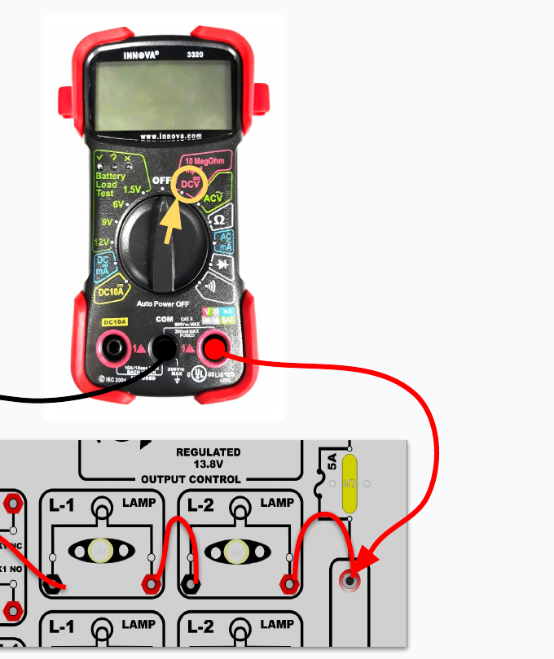
CIRCUIT MEASUREMENTS
Measure source voltage across the power supply
Vt - TOTAL VOLTAGE
1. Set the meter to DC volts.
2. Place the red lead on source positive and the black lead on source negative.
3. Record the available voltage before testing the rest of the circuit.
CIRCUIT MEASUREMENTS
13
Notes:
[Sources]
- User-provided source: EL - 05.1 Ohm's Law (Student Version).pdf
[/Sources]

Slide 14
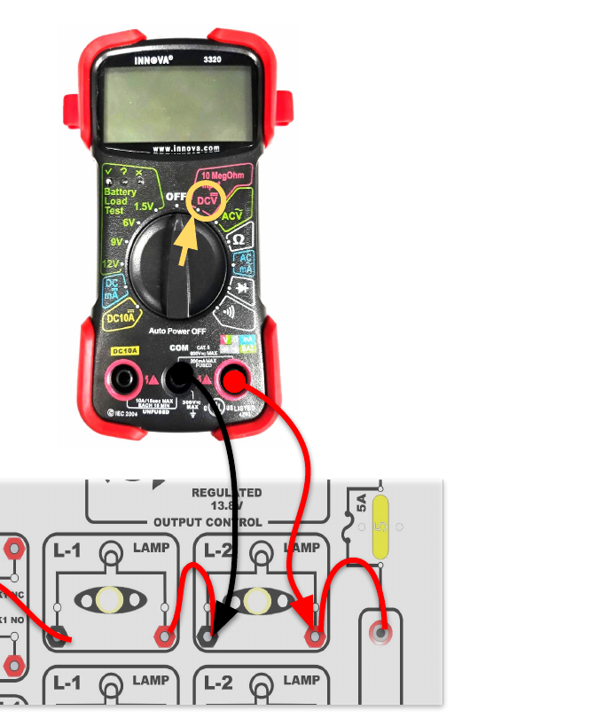
CIRCUIT MEASUREMENTS
Measure voltage drop across a powered load
VR1 - VOLTAGE DROP OF LOAD 1
1. Keep the circuit energized and operating.
2. Place one lead on each side of the load.
3. The reading shows how much electrical potential is dropped across that load.
Voltage is not "used up"; energy is transferred as voltage drops across loads.
CIRCUIT MEASUREMENTS
14
Notes:
[Sources]
- User-provided source: EL - 05.1 Ohm's Law (Student Version).pdf
[/Sources]

Slide 15
CIRCUIT MEASUREMENTS
Resistance requires a de-energized circuit
STOP: Remove power before connecting an ohmmeter.
Isolate the component
Discharge stored energy
Disconnect at least one side so other circuit paths do not change the reading.
Capacitors and powered modules can damage the meter or create a false reading.
Check the meter leads
Consider temperature
Short the leads together first; the reading should be near 0 ohms.
Metallic conductors usually gain resistance as temperature rises.
CIRCUIT MEASUREMENTS
15
Notes:
[Sources]
- User-provided source: EL - 05.1 Ohm's Law (Student Version).pdf
[/Sources]

Slide 16
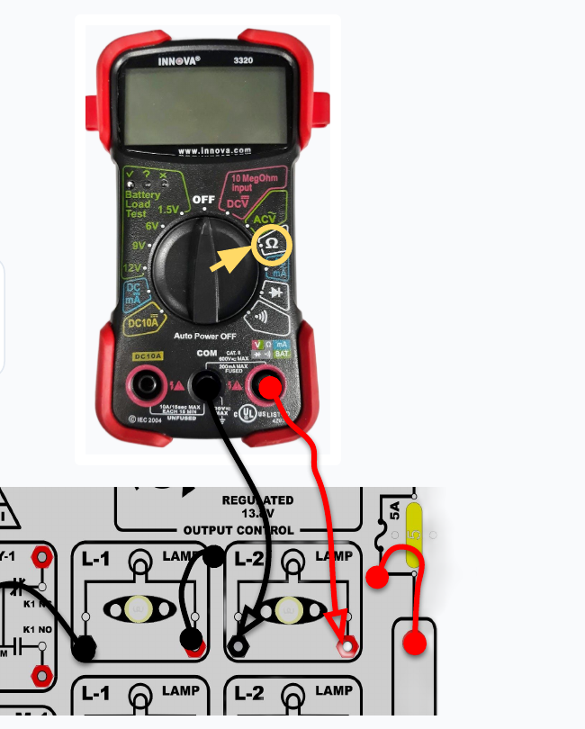
CIRCUIT MEASUREMENTS
Isolate the load before measuring R1
LOAD RESISTANCE
1. Remove circuit power.
2. Disconnect at least one load terminal.
3. Set the meter to ohms.
4. Place one lead on each side of the load.
CIRCUIT MEASUREMENTS
16
Notes:
[Sources]
- User-provided source: EL - 05.1 Ohm's Law (Student Version).pdf
[/Sources]

Slide 17
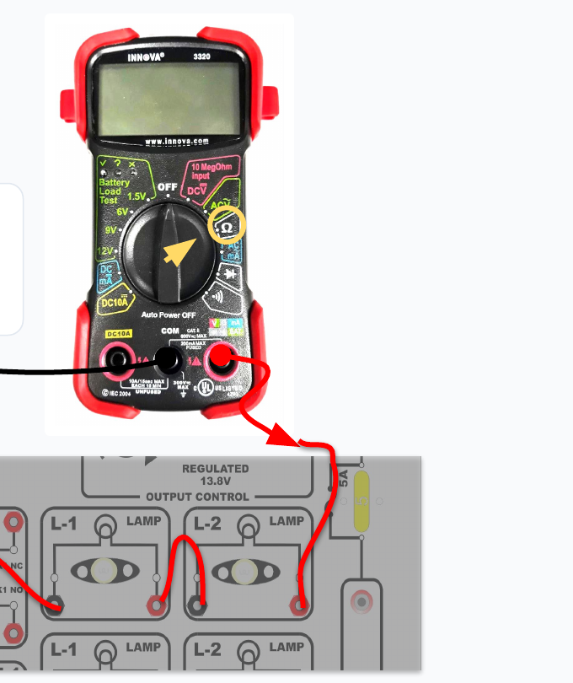
CIRCUIT MEASUREMENTS
Measure total resistance across the circuit
TOTAL RESISTANCE - Rt
1. Disconnect the circuit from the source.
2. Keep the intended circuit path complete.
3. Measure from the source-positive connection to the source-negative connection.
The reading is the equivalent resistance the source will see.
CIRCUIT MEASUREMENTS
17
Notes:
[Sources]
- User-provided source: EL - 05.1 Ohm's Law (Student Version).pdf
[/Sources]

Slide 18
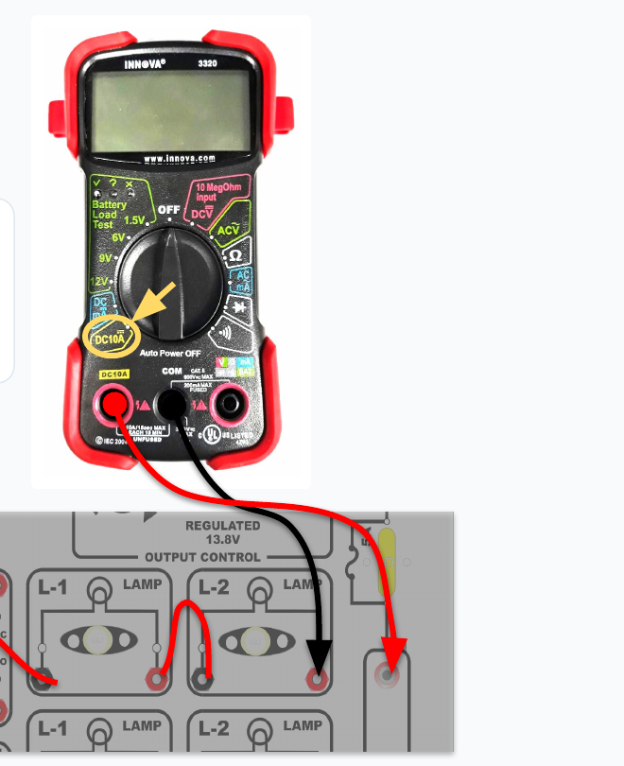
CIRCUIT MEASUREMENTS
An ammeter must become part of the circuit path
TOTAL CURRENT - It
1. Move the red lead to the correct current jack.
2. Open the circuit and connect the meter in series.
3. Start on the highest safe range.
4. Energize the circuit and read current.
Never place an ammeter directly across a voltage source.
CIRCUIT MEASUREMENTS
18
Notes:
[Sources]
- User-provided source: EL - 05.1 Ohm's Law (Student Version).pdf
[/Sources]

Slide 19
02
Watt's Law
Use voltage and current to calculate electrical power.
WATT'S LAW
19
Notes:
[Sources]
- User-provided source: EL - 05.1 Ohm's Law (Student Version).pdf
[/Sources]

Slide 20
WATT'S LAW
Power is the rate of energy transfer
P = V x I
Load rating
Bulbs, motors, heaters, and modules are rated in watts.
12 V x 2 A = 24 W
Heat
Higher power usually means more heat that wiring and components must handle.
If voltage stays constant, more current means more power. If current stays constant, more voltage means more power.
Diagnosis
Unexpected power can reveal excessive current draw or low available voltage.
WATT'S LAW
20
Notes:
[Sources]
- User-provided source: EL - 05.1 Ohm's Law (Student Version).pdf
[/Sources]

Slide 21
STUDENT PRACTICE
Apply Watt's Law
01
02
03
A 12 V lamp draws 3 A. Find power.
A 60 W load operates at 12 V. Find current.
A 24 W load draws 2 A. Find voltage.
Use P = V x I
Use I = P / V
Use V = P / I
Answer: __________ W
Answer: __________ A
Answer: __________ V
STUDENT PRACTICE
21
Notes:
[Sources]
- User-provided source: EL - 05.1 Ohm's Law (Student Version).pdf
[/Sources]

Slide 22
03
Series Circuits
One current path. Voltage divides. Resistance adds.
SERIES CIRCUITS
22
Notes:
[Sources]
- User-provided source: EL - 05.1 Ohm's Law (Student Version).pdf
[/Sources]

Slide 23
SERIES CIRCUITS
A series circuit has one path from positive to negative
One path
One open stops all loads
The same current passes through every load in sequence.
A break anywhere interrupts current through the entire circuit.
Voltage divides
Current stays the same
Each load drops part of the source voltage.
The same current flows through every series component.
More series resistance means less total current.
SERIES CIRCUITS
23
Notes:
[Sources]
- User-provided source: EL - 05.1 Ohm's Law (Student Version).pdf
[/Sources]

Slide 24
SERIES CIRCUITS
Four laws solve every basic series circuit
Voltage
Vt = VR1 + VR2 + ...
All voltage drops equal source voltage
Current
It = IR1 = IR2 = ...
Current is the same everywhere
Resistance
Rt = R1 + R2 + ...
All resistances add together
Power
Pt = PR1 + PR2 + ...
All load power adds together
SERIES CIRCUITS
24
Notes:
[Sources]
- User-provided source: EL - 05.1 Ohm's Law (Student Version).pdf
[/Sources]

Slide 25
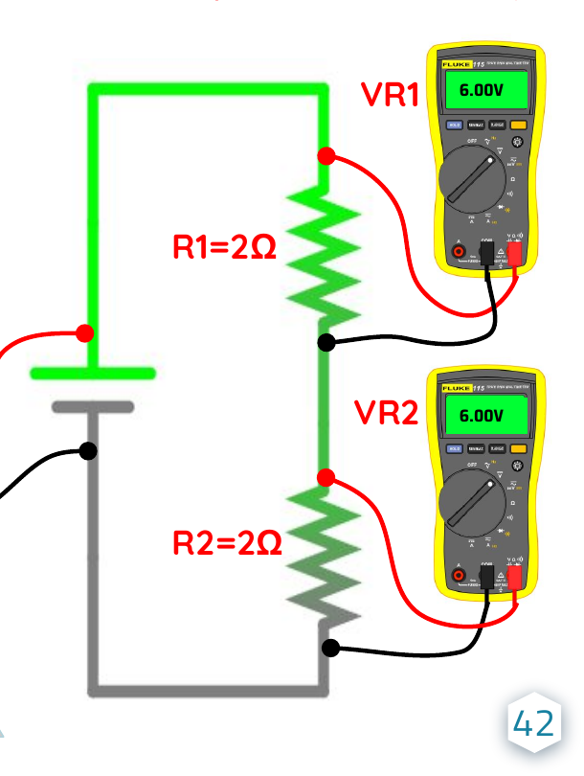
SERIES CIRCUITS
Each load has its own voltage drop and resistance
Vt
Source voltage
R1 / R2
Individual load resistance
VR1 / VR2
Voltage drop across each load
It
Same current through both loads
SERIES CIRCUITS
25
Notes:
[Sources]
- User-provided source: EL - 05.1 Ohm's Law (Student Version).pdf
[/Sources]

Slide 26
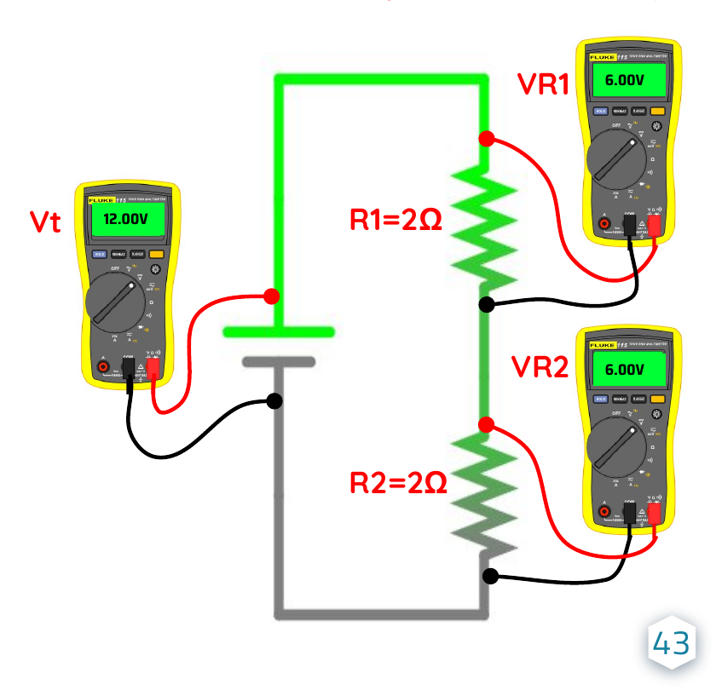
SERIES CIRCUITS
Series voltage drops add back to source voltage
KIRCHHOFF'S VOLTAGE LAW
Vt = VR1 + VR2
12 V = 6 V + 6 V
The load with the greatest resistance receives the greatest voltage drop.
SERIES CIRCUITS
26
Notes:
[Sources]
- User-provided source: EL - 05.1 Ohm's Law (Student Version).pdf
[/Sources]

Slide 27
SERIES CIRCUITS
Total resistance is the sum of every series load
Rt = R1 + R2 + ...
2 ohms
+
2 ohms
=
4 ohms
Adding a series load always increases total resistance and reduces current when source voltage stays constant.
SERIES CIRCUITS
27
Notes:
[Sources]
- User-provided source: EL - 05.1 Ohm's Law (Student Version).pdf
[/Sources]

Slide 28
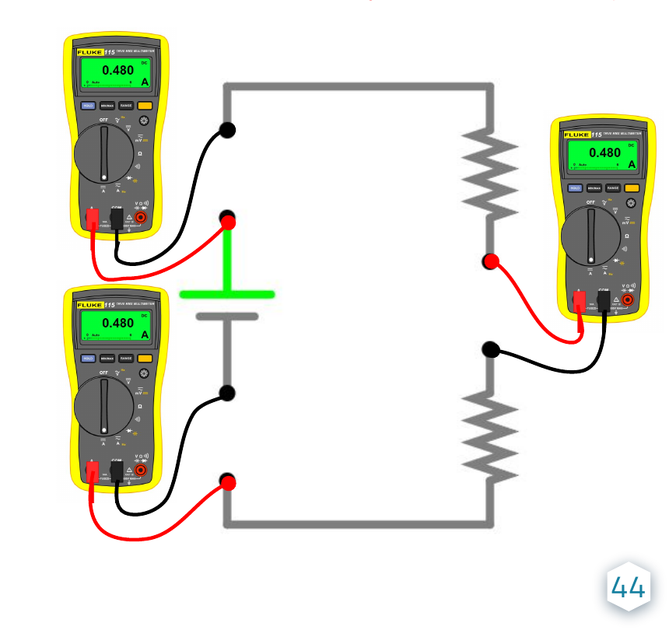
SERIES CIRCUITS
Current is the same at every point in a series circuit
It = IR1 = IR2
0.480 A = 0.480 A = 0.480 A
An ammeter placed anywhere in the single current path should show the same reading.
SERIES CIRCUITS
28
Notes:
[Sources]
- User-provided source: EL - 05.1 Ohm's Law (Student Version).pdf
[/Sources]

Slide 29
WORKED EXAMPLE
Solve the series circuit one relationship at a time
Given: Vt = 12 V R1 = 2 ohms R2 = 4 ohms
1
2
3
4
5
Find Rt
Find It
Find VR1
Find VR2
Verify
2 + 4 = 6 ohms
12 / 6 = 2 A
2 A x 2 ohms = 4 V
2 A x 4 ohms = 8 V
4 V + 8 V = 12 V
WORKED EXAMPLE
29
Notes:
[Sources]
- User-provided source: EL - 05.1 Ohm's Law (Student Version).pdf
[/Sources]

Slide 30
STUDENT PRACTICE
Series circuit problems
01
Find Vt: It = 2 A, R1 = 3 ohms, VR2 = 12 V
02
Find Vt: R1 = 3 ohms, R2 = 2 ohms, VR2 = 4 V
Answer: ____________________
Answer: ____________________
03
Find VR1: It = 2 A, R1 = 3 ohms
04
Find VR1: It = 2 A, R2 = 4 ohms, Vt = 14 V
Answer: ____________________
Answer: ____________________
05
Find Rt: Vt = 14 V, R1 = 3 ohms, It = 2 A
06
Find Rt: R1 = 3 ohms, VR2 = 4 V, It = 2 A
Answer: ____________________
Answer: ____________________
STUDENT PRACTICE
30
Notes:
[Sources]
- User-provided source: EL - 05.1 Ohm's Law (Student Version).pdf
[/Sources]

Slide 31
04
Parallel Circuits
Multiple current paths. Equal branch voltage. Current adds.
PARALLEL CIRCUITS
31
Notes:
[Sources]
- User-provided source: EL - 05.1 Ohm's Law (Student Version).pdf
[/Sources]

Slide 32
PARALLEL CIRCUITS
Parallel branches share the same two nodes
Multiple paths
Equal branch voltage
Current can travel through more than one branch from positive to negative.
Each branch has the full source voltage across it.
Current divides and recombines
Resistance decreases
Total current equals the sum of all branch currents.
Adding a branch lowers equivalent resistance and increases total current.
One failed branch does not stop current through the remaining branches.
PARALLEL CIRCUITS
32
Notes:
[Sources]
- User-provided source: EL - 05.1 Ohm's Law (Student Version).pdf
[/Sources]

Slide 33
COMPARE
Series and parallel circuits follow different rules
Feature | Series | Parallel
Current paths | One | Two or more
Current | Same everywhere | Splits among branches
Voltage | Divides across loads | Full source voltage across each branch
Resistance | Adds together | Lower than the smallest branch
Single open | Stops the entire circuit | Only stops the affected branch
Common use | Simple chains and sensors | Automotive lighting and accessories
COMPARE
33
Notes:
[Sources]
- User-provided source: EL - 05.1 Ohm's Law (Student Version).pdf
[/Sources]

Slide 34
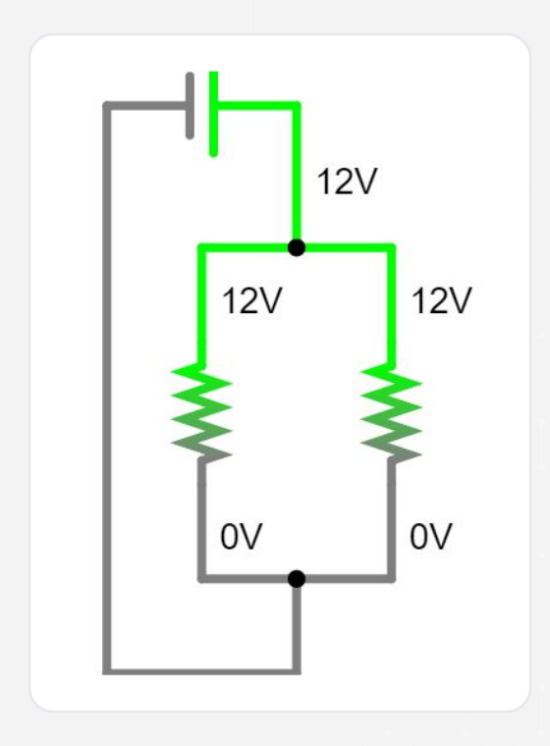
PARALLEL CIRCUITS
Every branch receives the full source voltage
Vt = VR1 = VR2
12 V = 12 V = 12 V
Treat each branch like its own circuit connected directly across the source.
PARALLEL CIRCUITS
34
Notes:
[Sources]
- User-provided source: EL - 05.1 Ohm's Law (Student Version).pdf
[/Sources]

Slide 35
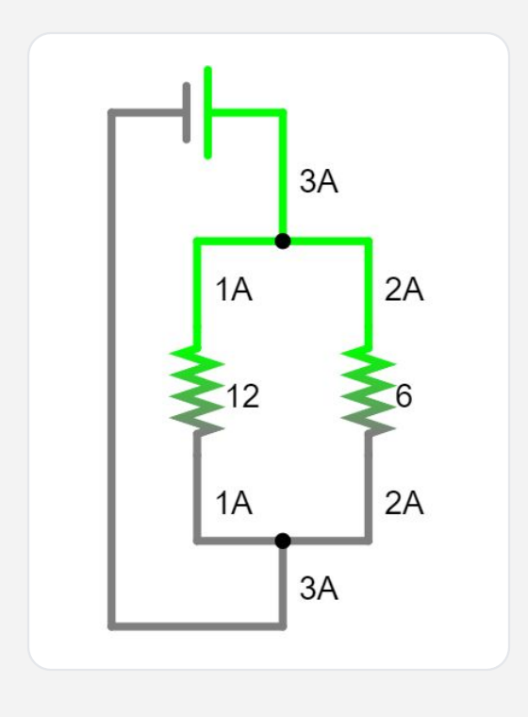
PARALLEL CIRCUITS
Branch resistance determines branch current
IR = VR / R
12 V / 12 ohms = 1 A
12 V / 6 ohms = 2 A
The lower-resistance branch carries more current.
PARALLEL CIRCUITS
35
Notes:
[Sources]
- User-provided source: EL - 05.1 Ohm's Law (Student Version).pdf
[/Sources]

Slide 36
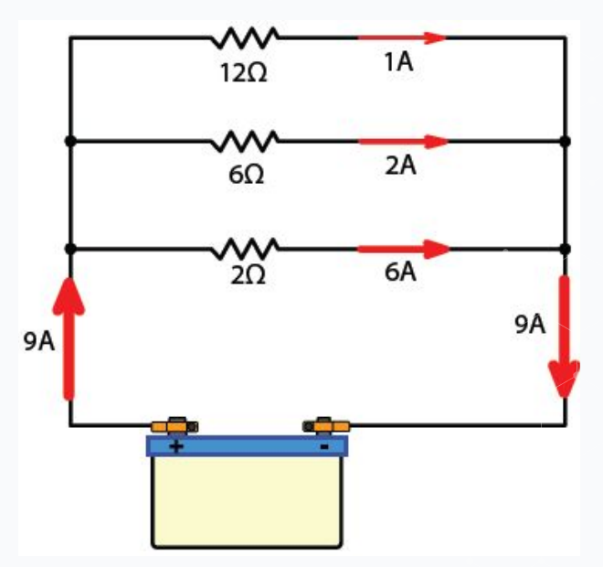
PARALLEL CIRCUITS
Total current is the sum of all branch currents
It = IR1 + IR2 + IR3
1 A + 2 A + 6 A = 9 A
The total current leaves the source, divides among the branches, and recombines before returning.
PARALLEL CIRCUITS
36
Notes:
[Sources]
- User-provided source: EL - 05.1 Ohm's Law (Student Version).pdf
[/Sources]

Slide 37
PARALLEL CIRCUITS
Parallel Rt is lower than the smallest branch
Rt < smallest branch resistance
01
02
03
Equal branches
Two unequal branches
Any number of branches
Rt = branch R / number of branches
Rt = (R1 x R2) / (R1 + R2)
Rt = 1 / (1/R1 + 1/R2 + ...)
PARALLEL CIRCUITS
37
Notes:
[Sources]
- User-provided source: EL - 05.1 Ohm's Law (Student Version).pdf
[/Sources]

Slide 38
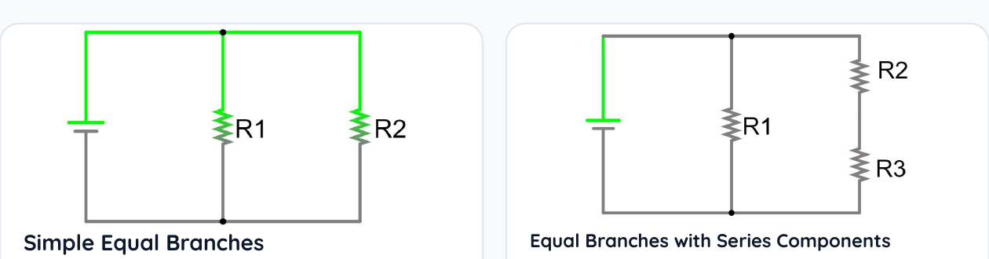
PARALLEL RESISTANCE
Equal branches use the fastest resistance shortcut
Simple equal branches
Equal branches with series loads
4 ohms / 2 branches = 2 ohms
6 ohms / 2 branches = 3 ohms
PARALLEL RESISTANCE
38
Notes:
[Sources]
- User-provided source: EL - 05.1 Ohm's Law (Student Version).pdf
[/Sources]

Slide 39
PARALLEL RESISTANCE
Two unequal branches use product over sum
Rt = (R1 x R2) / (R1 + R2)
Example: 2 ohms in parallel with 4 ohms
Rt = (2 x 4) / (2 + 4) = 8 / 6 = 1.33 ohms
Quick check: 1.33 ohms is less than the smallest branch, 2 ohms.
PARALLEL RESISTANCE
39
Notes:
[Sources]
- User-provided source: EL - 05.1 Ohm's Law (Student Version).pdf
[/Sources]

Slide 40
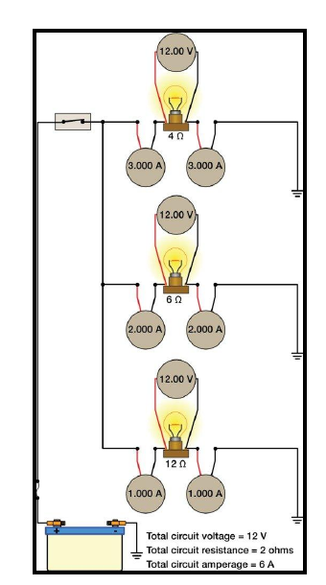
PARALLEL RESISTANCE
Use reciprocals for any branch count
Rt = 1 / (1/R1 + 1/R2 + 1/R3)
Example: 4 ohms, 6 ohms, and 12 ohms
1/Rt = 1/4 + 1/6 + 1/12
1/Rt = 0.25 + 0.167 + 0.083
1/Rt = 0.50
Rt = 2 ohms
PARALLEL RESISTANCE
40
Notes:
[Sources]
- User-provided source: EL - 05.1 Ohm's Law (Student Version).pdf
[/Sources]

Slide 41
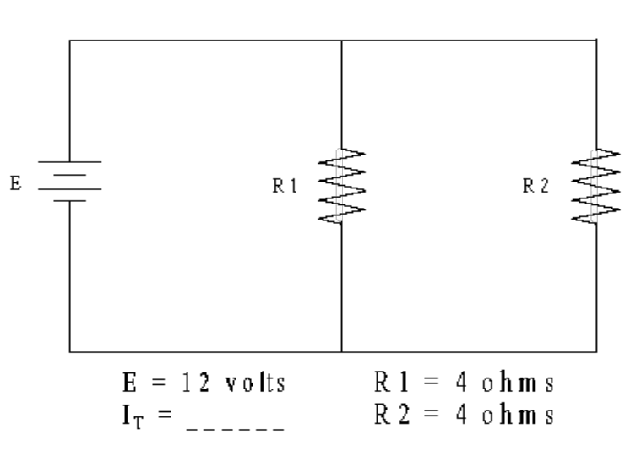
WORKED EXAMPLE
Find total current in two equal parallel branches
METHOD 1 - TOTAL RESISTANCE
Rt = 4 ohms / 2 branches = 2 ohms
It = 12 V / 2 ohms = 6 A
METHOD 2 - BRANCH CURRENT
IR1 = 12 V / 4 ohms = 3 A
IR2 = 12 V / 4 ohms = 3 A
It = 3 A + 3 A = 6 A
WORKED EXAMPLE
41
Notes:
[Sources]
- User-provided source: EL - 05.1 Ohm's Law (Student Version).pdf
[/Sources]

Slide 42
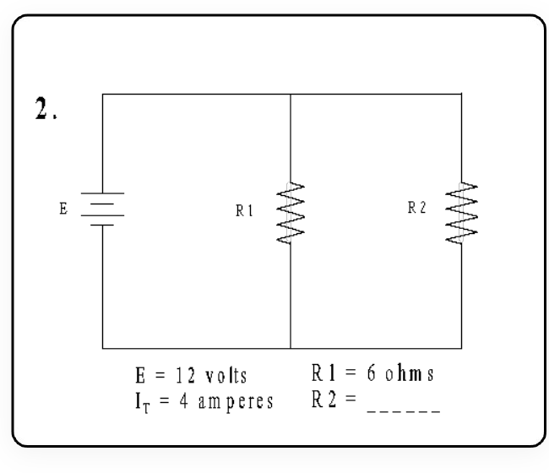
WORKED EXAMPLE
Use total current to solve for an unknown branch
Given: Vt = 12 V, It = 4 A, R1 = 6 ohms
1
Find IR1
12 V / 6 ohms = 2 A
2
Find IR2
4 A - 2 A = 2 A
3
Find R2
12 V / 2 A = 6 ohms
WORKED EXAMPLE
42
Notes:
[Sources]
- User-provided source: EL - 05.1 Ohm's Law (Student Version).pdf
[/Sources]

Slide 43
STUDENT PRACTICE
Parallel circuit problems
01
02
03
Two 12 ohm branches are connected to 12 V. Find Rt and It.
A 6 ohm branch and a 3 ohm branch share 12 V. Find both branch currents and It.
Three branches are 4, 6, and 12 ohms. Find Rt and It at 12 V.
Equal branches, then I = V / R
IR = V / R; currents add
Use the reciprocal formula
Answer: __________ Rt / It
Answer: __________ A
Answer: __________ Rt / It
STUDENT PRACTICE
43
Notes:
[Sources]
- User-provided source: EL - 05.1 Ohm's Law (Student Version).pdf
[/Sources]

Slide 44
REFERENCE
Circuit formula sheet
Find | Basic formula | Series rule | Parallel rule
Voltage | V = I x R | Vt = VR1 + VR2 + ... | Vt = VR1 = VR2 = ...
Current | I = V / R | It = IR1 = IR2 = ... | It = IR1 + IR2 + ...
Resistance | R = V / I | Rt = R1 + R2 + ... | Rt < smallest branch
Power | P = V x I | Pt = PR1 + PR2 + ... | Pt = PR1 + PR2 + ...
Equal parallel R | - | - | Rt = branch R / branches
Two parallel R | - | - | Rt = R1 x R2 / (R1 + R2)
Any parallel R | - | - | Rt = 1 / (1/R1 + 1/R2 + ...)
Verification | Use units | Sum of drops = source | Sum of branch I = total I
REFERENCE
44
Notes:
[Sources]
- User-provided source: EL - 05.1 Ohm's Law (Student Version).pdf
[/Sources]

Slide 45
EXIT TICKET
Show what you know
1. A 12 V circuit has 4 ohms of resistance. What is current?
2. What must happen to current if resistance increases and voltage stays constant?
3. Name one rule that is different in series and parallel circuits.
4. Which meter measurement requires the meter to be connected in series?
Explain one answer in your own words.
EXIT TICKET
45
Notes:
[Sources]
- User-provided source: EL - 05.1 Ohm's Law (Student Version).pdf
[/Sources]

